Slide 1
Recommendation System

Slide 2
What is Recommendation System
Recommendation systems are algorithms designed to predict and suggest items or actions to users based on their preferences and past interactions.

Slide 3
Where the Recommendation System is used?
Recommendation systems play a crucial role in enhancing user experience across diverse industries such as E-commerce, Streaming Services, Social Media, and more.

Slide 4
Why the Recommendation System is important?
They help users discover relevant content, products, or services, leading to increased user engagement, satisfaction, and ultimately, higher revenues for businesses.

Slide 5

Example

Slide 6
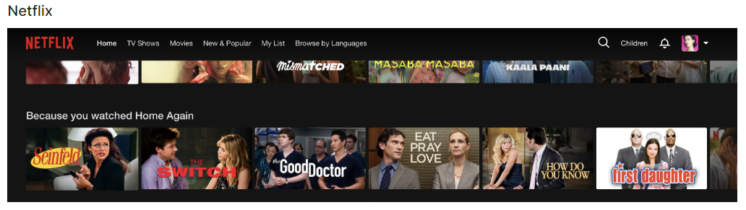
Example

Slide 7
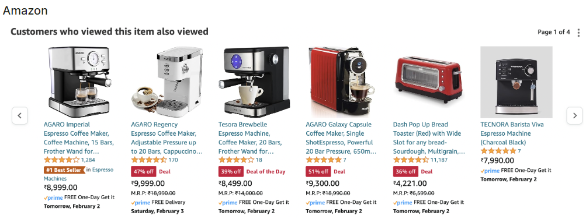
Example

Slide 8
Types of Recommendation System
Popularity Based
Content-Based Filtering
Collaborative-Based Filtering
Hybrid Recommendation Systems

Slide 9
Popularity Based
A popularity-based recommendation system suggests items to users based on the overall popularity among all users.
How it Works:
Identifies popular items based on factors such as views, purchases, ratings, or likes.
Recommends these popular items to all users, regardless of their individual preferences.
Example:
YouTube: Trending Videos
Twitter: Trending Topics

Slide 10
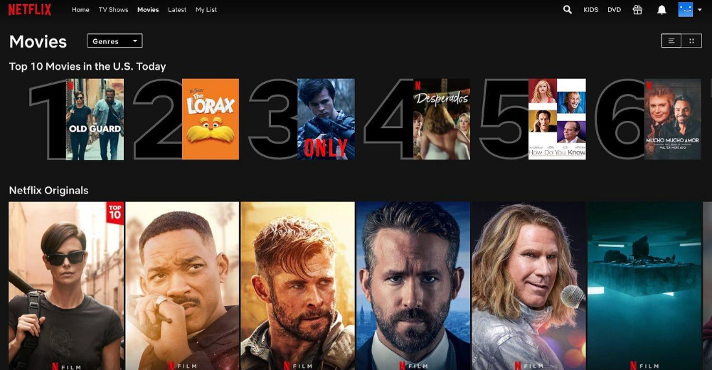
Popularity Based Example

Slide 11
Content Based
Content-based filtering recommends items to users based on the similarity between items and user preferences.
How it Works:
Analyzes item attributes such as text, keywords, or metadata.
Recommends items that are similar to those the user has liked or interacted with in the past.
Example:
Netflix: Movie Recommendations
Spotify: Music Recommendations
Amazon: Product Recommendations

Slide 12
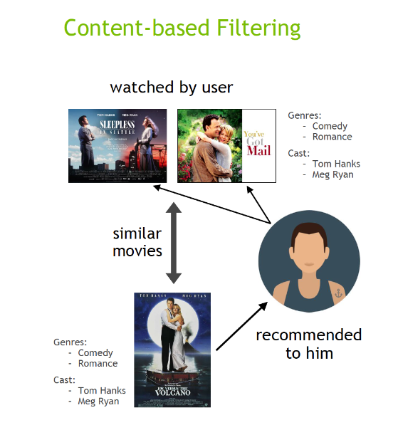
Content Based Example

Slide 13
Collaborative Filtering
Collaborative filtering recommends items to users based on the preferences and behaviors of similar users.
How it Works:
Identifies users with similar preferences based on their past interactions.
Recommends items liked or preferred by similar users but not yet interacted with by the target user.
Example:
Netflix: Movie Recommendations
Spotify: Music Recommendations
Amazon: Product Recommendations

Slide 14
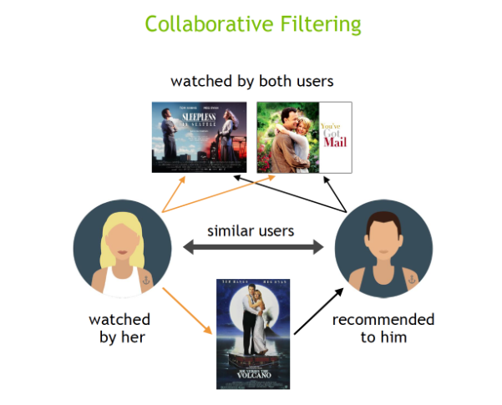
Collaborative Based Example

Slide 15
Types of Collaborative Filtering
User-Based Collaborative Filtering
Item-Based Collaborative Filtering

Slide 16
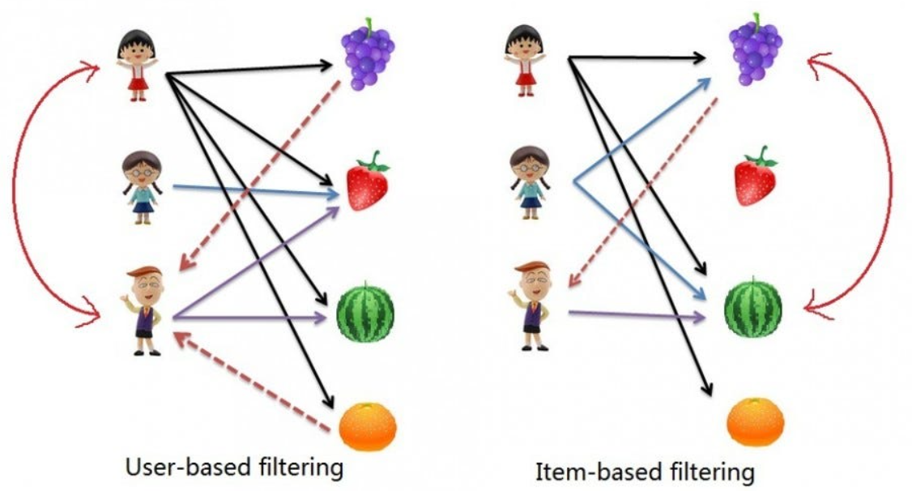
User-Based & Item-Based Example

Slide 17
Hybrid Recommendation System
Hybrid recommendation systems combine multiple recommendation approaches, such as content-based and collaborative filtering, to provide more accurate and personalized recommendations.
How it Works:
Integrates different recommendation algorithms to leverage their strengths and mitigate their weaknesses.
Combines user preferences, item attributes, and collaborative filtering techniques to generate recommendations.
Example:
Netflix combining content-based analysis of movie attributes with collaborative filtering based on user preferences.

Slide 18
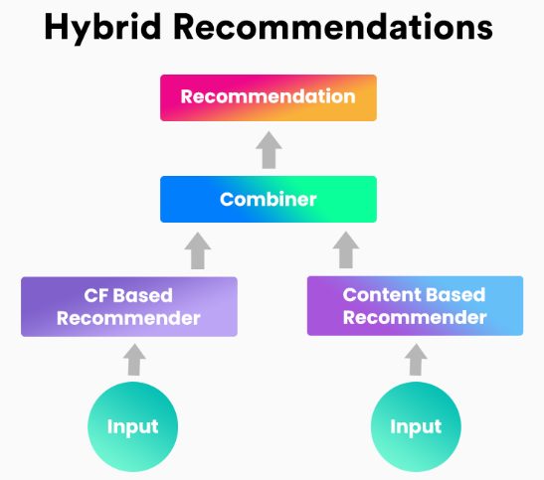
Collaborative Based Example

Slide 19
Practical Implementation

Slide 20
Thank you

